Slide 1
John Cage
John Cage (1912 –1992) was an American composer and music theorist. A pioneer of indeterminacy in music, electroacoustic music, and non-standard use of musical instruments, Cage was one of the leading figures of the post-war avant-garde. Critics have lauded him as one of the most influential composers of the 20th century. He was also instrumental in the development of modern dance, mostly through his association with choreographer Merce Cunningham, who was also Cage's romantic partner for most of their lives
Music Computation and Complexity
Marco Buongiorno Nardelli

Slide 2
Cage – Music of changes
Music of Changes is a piece for solo piano composed in 1951 for pianist and friend David Tudor. The process of composition involved applying decisions made using the I Ching, a Chinese classic text that is commonly used as a divination system. The I Ching was applied to large charts of sounds, durations, dynamics, tempo and densities

Slide 3
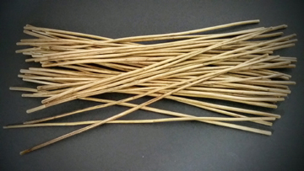
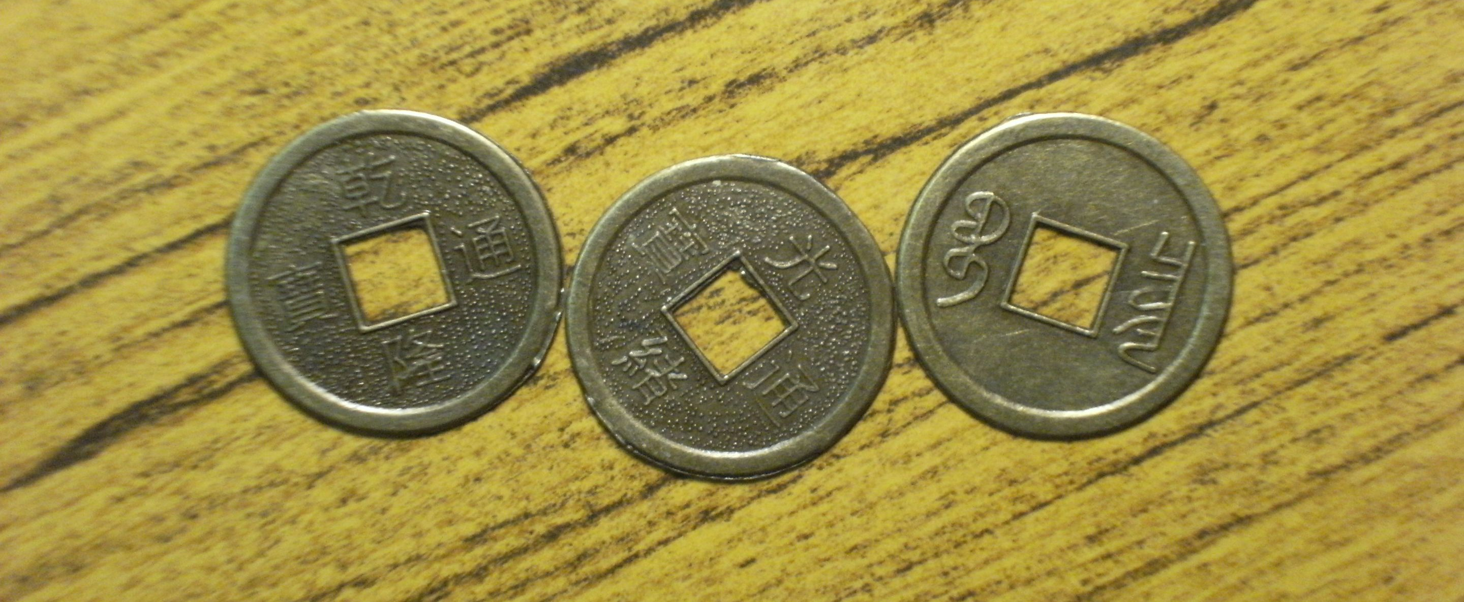
Cage – Music of Changes
The text of the I Ching consists of sixty-four hexagrams: six-line figures of yin (broken) or yang (solid) lines, and commentaries on them. There are two main methods of building up the lines of the hexagram, using either 50 yarrow sticks or three coins. Some of the lines may be designated "old" lines, in which case the lines are subsequently changed to create a second hexagram. The text relating to the hexagram(s) and old lines (if any) is studied, and the meanings derived from such study can be interpreted as an oracle.

Slide 4
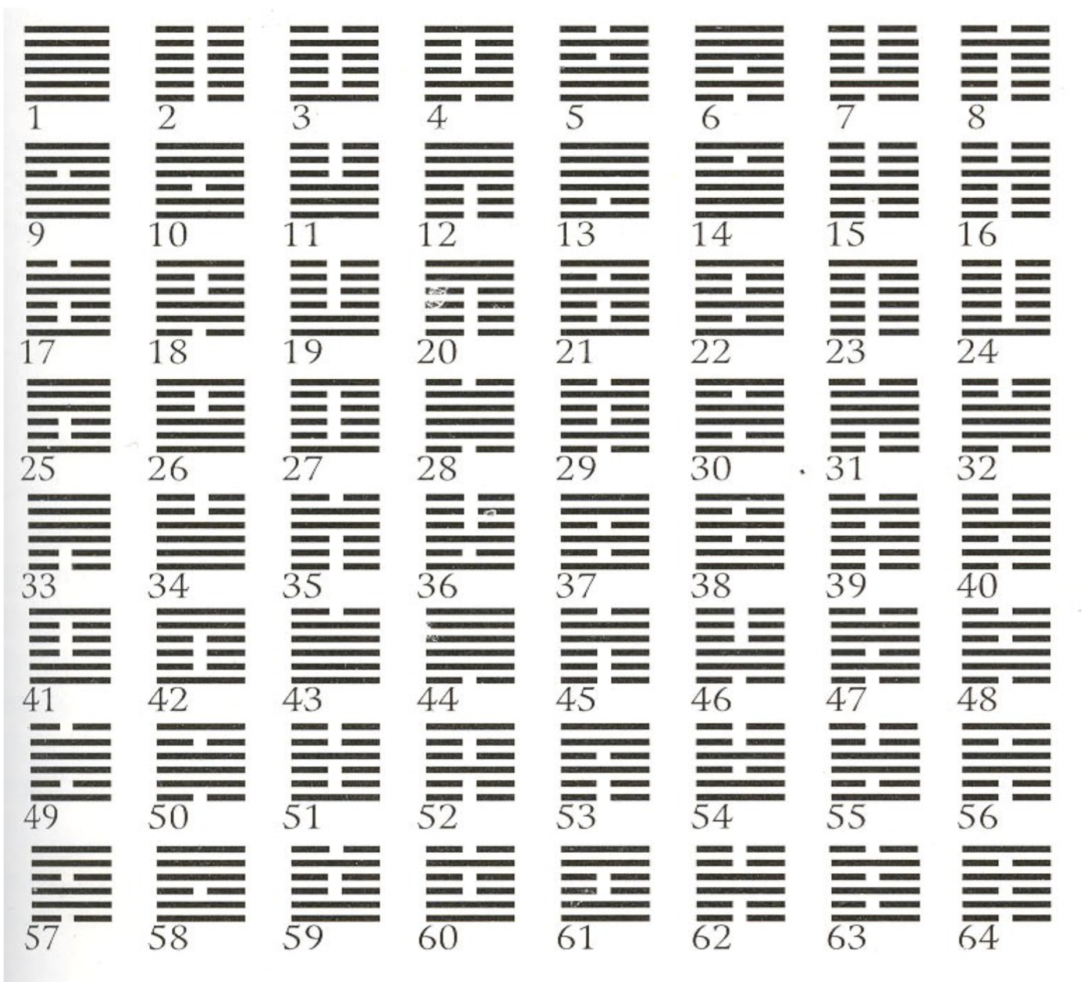
Cage – Music of Changes
The text of the I Ching consists of sixty-four hexagrams: six-line figures of yin (broken) or yang (solid) lines, and commentaries on them. There are two main methods of building up the lines of the hexagram, using either 50 yarrow sticks or three coins. Some of the lines may be designated "old" lines, in which case the lines are subsequently changed to create a second hexagram. The text relating to the hexagram(s) and old lines (if any) is studied, and the meanings derived from such study can be interpreted as an oracle.

Slide 5
Cage – Music of Changes
Cage employed I Ching-derived chance operations to create charts for the various parameters, i.e. tempi, dynamics, sounds and silences, durations, and superpositions. With these charts, he was able to create a composition with a very conventional manner of notation, with staves and bars, where everything is notated in full detail. The piano is played not only by using the keys, but also by plucking the strings with fingernails, slamming the keyboard lid, playing cymbal beaters on the strings, striking the keyboard lid, etc. Use of the pedals is also notated in full detail. The notation is proportional, where 1 inch equals a quarter note. The rhythmic structure is 3, 5, 6 3/4, 6 3/4, 5, 3 1/8, and is expressed in changing tempi, including the use of accelerandi and ritards.

Slide 6
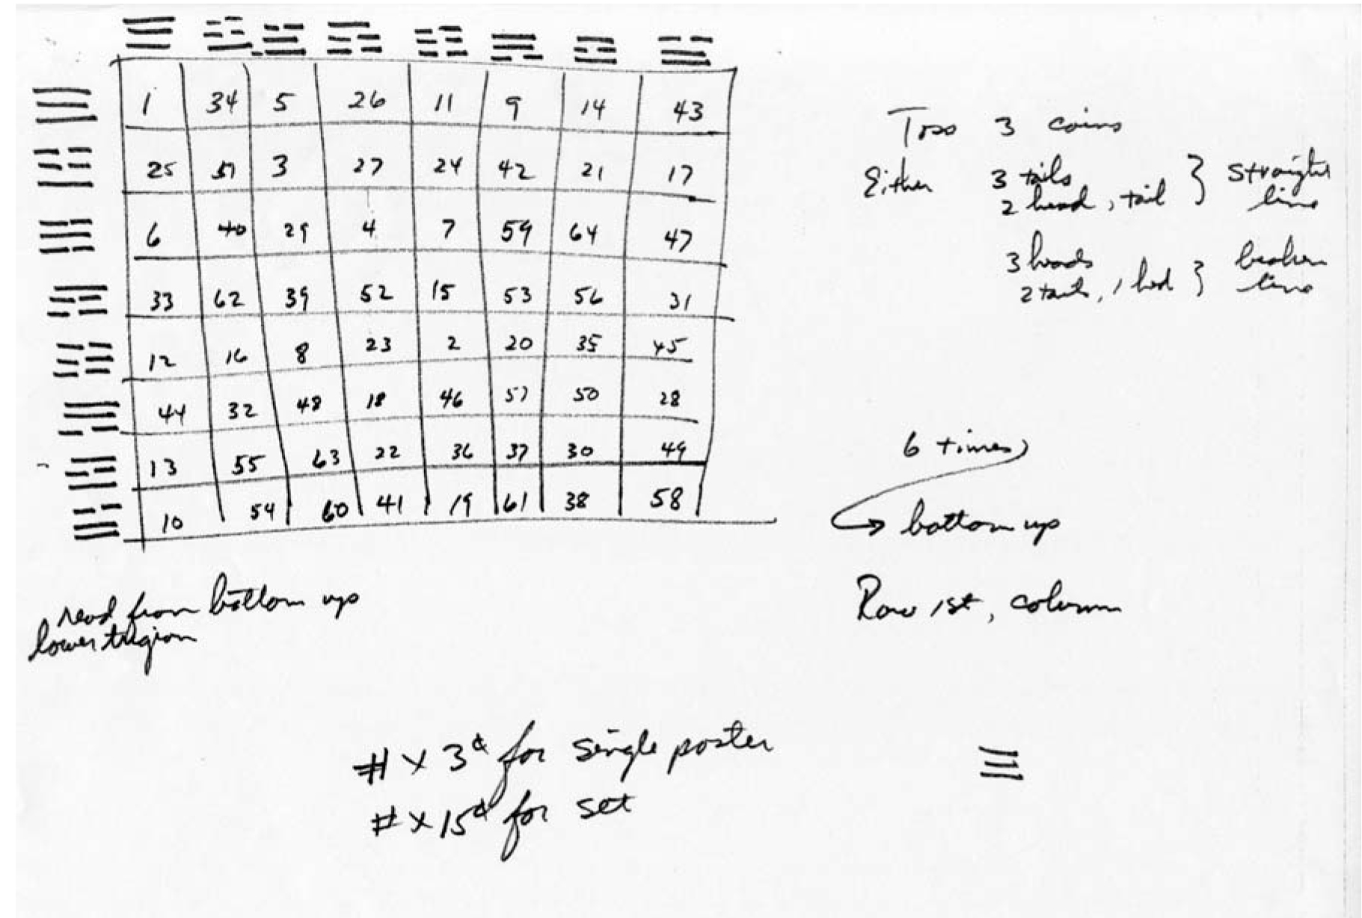

Slide 7
Cage – Music of Changes
Mapping parameters - charts:
Eight charts containing sounds and silences
Eight charts with durations,
Eight charts with amplitudes (dynamics) single chart for determining tempi and the number of contrapuntal layers
Each chart has eight rows and eight columns of cells
Precompositional decisions:
The sound charts consist of single pitches, intervals, aggregates, and constellations (more complex rhythmic combinations)
Vertical and horizontal axes of sound charts must include all twelve tones of the chromatic scale
Similar precompositional decisions for rhythm

Slide 8
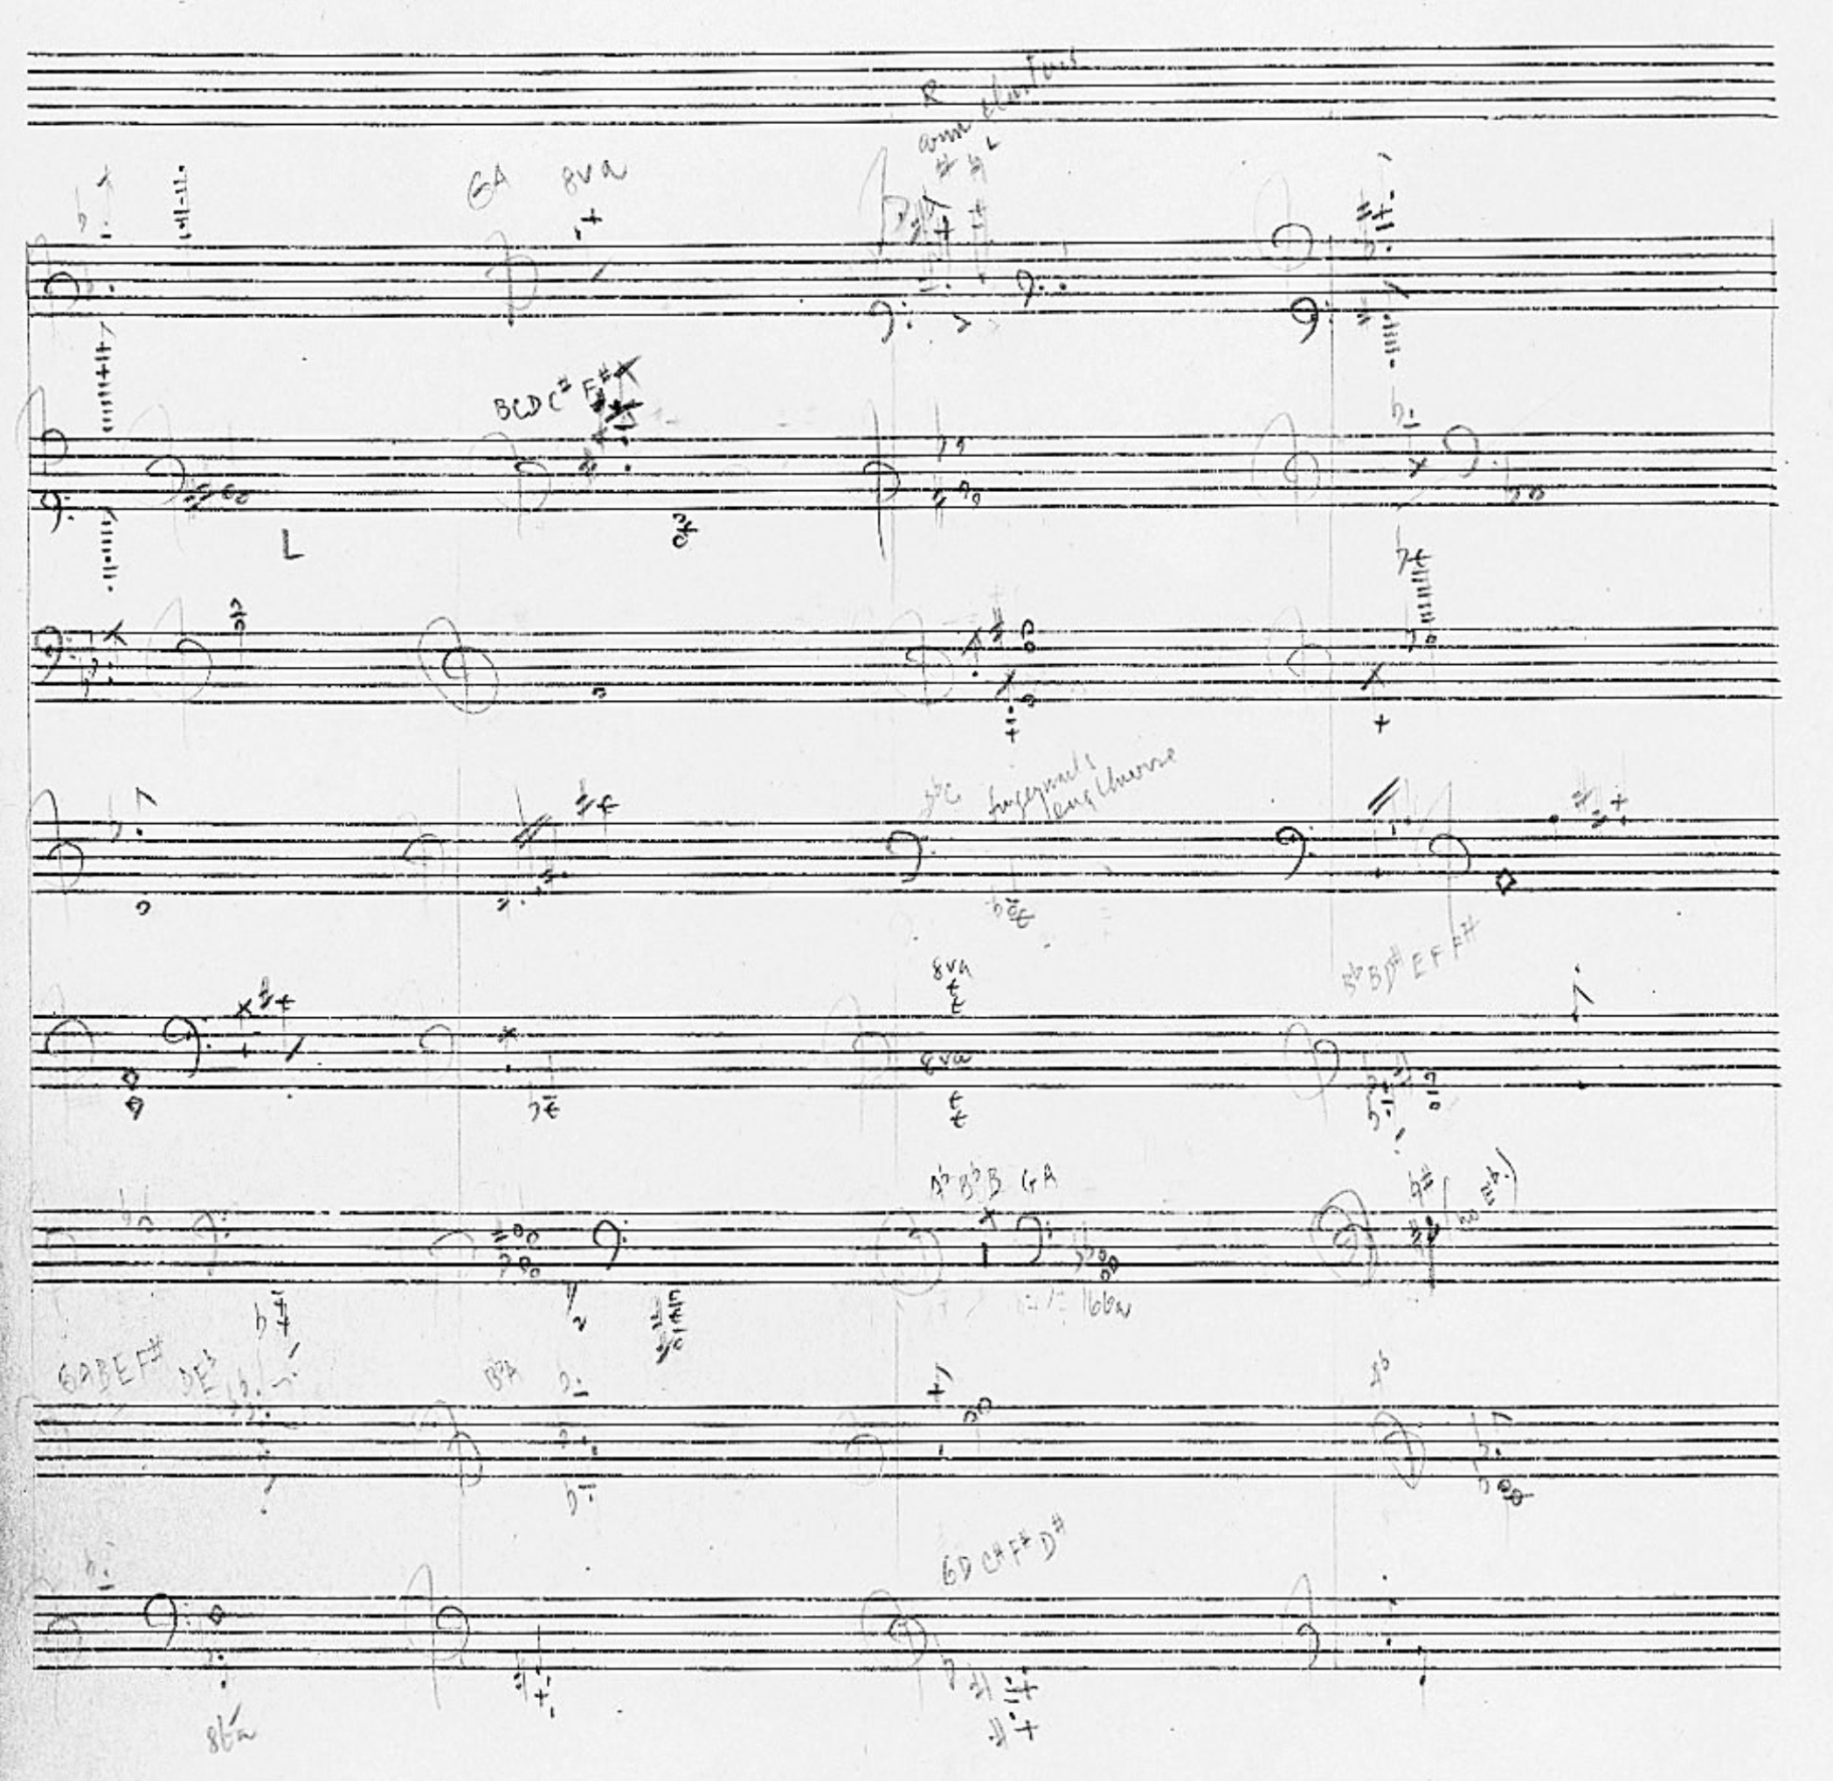

Slide 9
